Slide 1

Team 56: Fall Detection
Bi-Weekly Update 1 Justin Haryanto, Nhan Nguyen
Sponsor: Krishna Gadepally TA: Swarnabha Roy, Dalton W. Cyr
Notes:
30 seconds

Slide 2
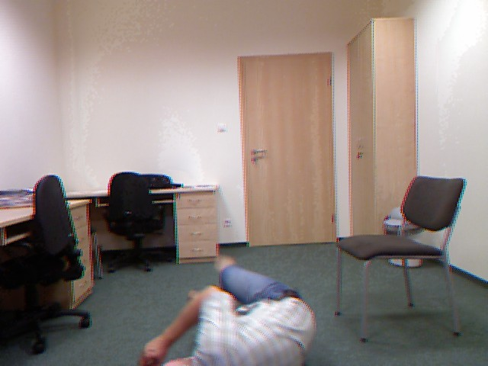
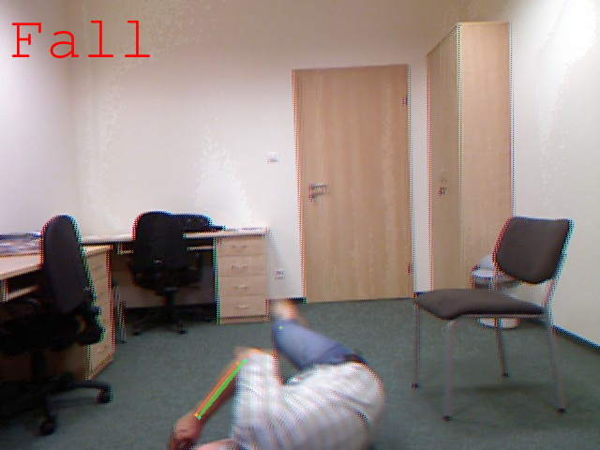
Project Summary
Problem
Design a video-based fall detection system
Solution
Convert video to a useable images
Apply bounding boxes and key points on people in images using pose estimation
Determine if a fall has occurred using Random Forests and CNN machine learning models
Notes:
30 seconds

Slide 3
Project/Subsystem Overview 403
Diagram showing subsystems – with labels showing subsystem owners
Bullets giving essential system/subsystem characteristics
If major changes in subsystems, show before and after … see next slide
Video Input
Video Processing + Pose Estimation
AlphaPose is used to process the input data
Keypoint and bounding boxes are applied to each person
Fall Detection
Machine learning models used to determine falls
Random forests works on keypoints, CNN works on bounding boxes
Video Processing
Nhan
Pose Estimation
Justin
Random Forests
CNN
Result Output
Notes:
45 seconds

Slide 4
Major Project Changes for 404
Bullets on changes due to team membership changes -- describe how subsystem assignments, roles, project will change to accommodate team changes
Bullets on MAJOR changes in project direction due to learning from 403. If stuff didn’t work out now is the time to redirect
-- eg custom to COTS, MCU changes, application change, major change in communication technology, …
No further improvements will be made to the Video Processing & Pose Estimation Subsystem
Nhan is now working on improving the machine learning models of the Fall Detection Subsystem
Justin is working on the new Externals Subsystem
Making more datasets to help train the ML models
Live video feed
UI for interacting with the program
Live Video
Video Processing
& Pose Estimation
Datasets
Random Forests
CNN
Justin
Nhan
UI
Notes:
45 seconds

Slide 5
Project Timeline
Not Started
In Progress
Finished
Live Video
Video Processing
& Pose Estimation
Datasets
Random Forests
CNN
UI
Notes:
30 seconds
High level figure showing where you are at in the project, what’s completed, what’s underway – it should take about 30 seconds to summarize where you are in the timeline
-- Save discussion for subsystem update
-- Save detail for execution plan & validation plan status

Slide 6
Video Processing + Pose Estimation
Nhan Nguyen
Accomplishments since 403 08 hrs of effort | Ongoing progress/problems and plans until the next presentation
We discussed amongst ourselves, with the professor, and sponsor on rearranging tasks and goals. We planned out new subsystems. | Models have limited training data sets. Plan on training/refining the random forest and CNN models and integrating the fall detection and pose estimation systems. Incorporate more datasets.
Notes:
45 seconds

Slide 7
Video Processing + Pose Estimation
Nhan Nguyen
Interesting figure related to your subsystem progress
Detail on what works, what doesn’t, what is changing
Currently, managed to use AlphaPose to extract keypoints and bounding boxes from our data
Only used image data sets, Justin working to get live video feed using laptop/phone cameras
Not used AlphaPose with video directly nor got Alphapose to work rapidly with our systems
We intend to speed things up for live video feed to be usable.
Notes:
45 seconds

Slide 8
Fall Detection
Justin Haryanto
Accomplishments since 403 08 hrs of effort | Ongoing progress/problems and plans until the next presentation
We discussed amongst ourselves, with the professor, and sponsor on rearranging tasks and goals. We planned out new subsystems. | Finding more data sets for Nhan Preparing the data sets to be usable for training
Notes:
45 seconds

Slide 9
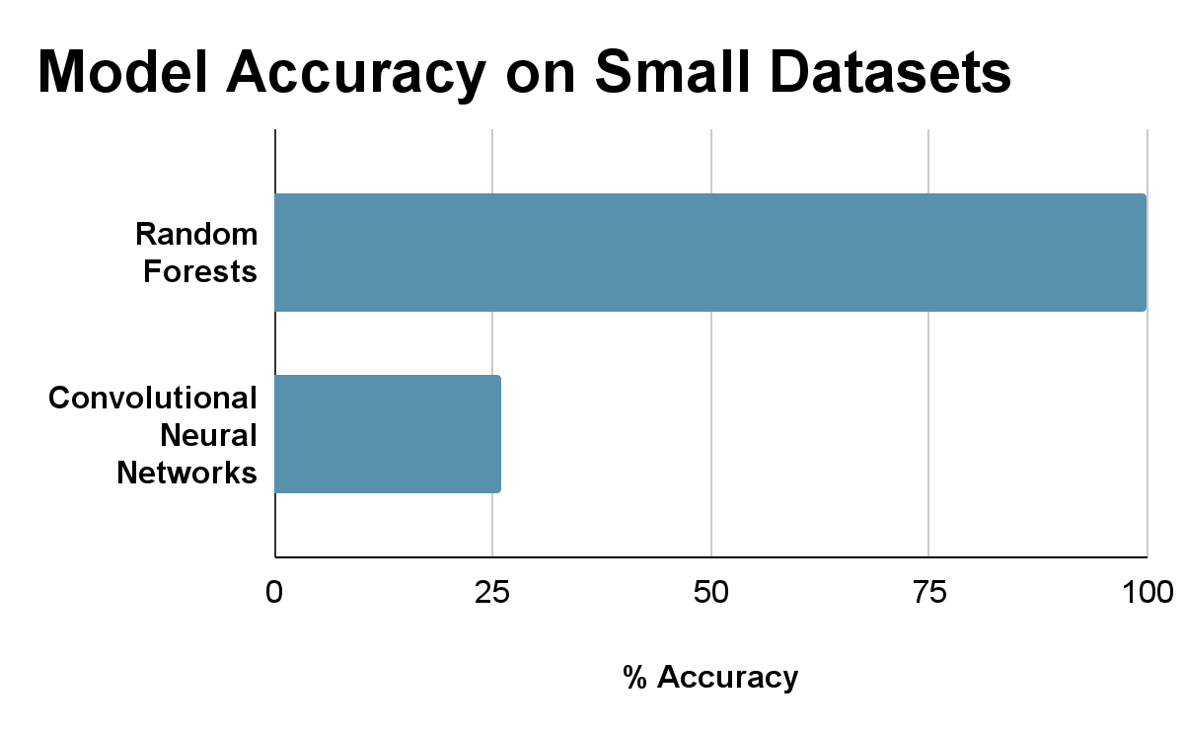
Fall Detection
Justin Haryanto
Interesting figure related to your subsystem progress
Detail on what works, what doesn’t, what is changing
Each model given limited data sets containing hundreds of images
Random Forests performed well likely due to testing on a small data set
Need to test on larger data sets
CNN model performed poorly due to lack of layers
Need more training and model refinement
More data sets are being made
Models are being refined by Nhan
Notes:
45 seconds

Slide 10
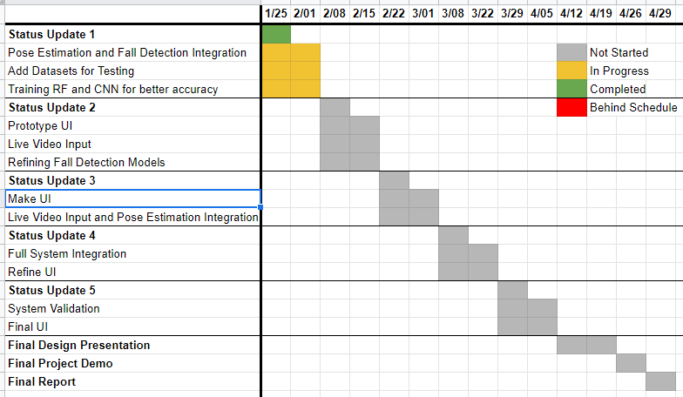
Execution Plan
Notes:
45 seconds

Slide 11
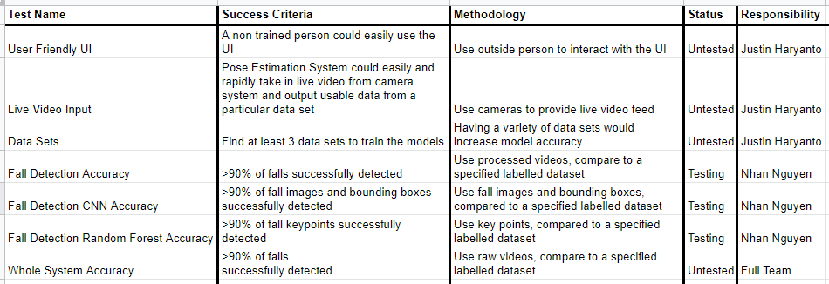
Validation Plan
Notes:
45 seconds

Slide 12
Thank You
Notes:
30 seconds

